Slide 1


Telecom Customer Churn
Group A:
Anusha Kokkinti
Shruti Jituri
Tejaswini Mummadi

Slide 2
Agenda
Introduction
Data
Data Visualization
Predictive Analysis
Conclusion

Slide 3
Introduction
Customer Churn
Customer Analytics

Slide 4
Data
customerID
gender
SeniorCitizen
Partner
Dependents
tenure
PhoneService
MultipleLines
InternetService
OnlineSecurity
OnlineBackup
DeviceProtection
TechSupport
StreamingTV
StreamingMovies
Contract
PaperlessBilling
PaymentMethod
MonthlyCharges
TotalCharges
Churn

Slide 5
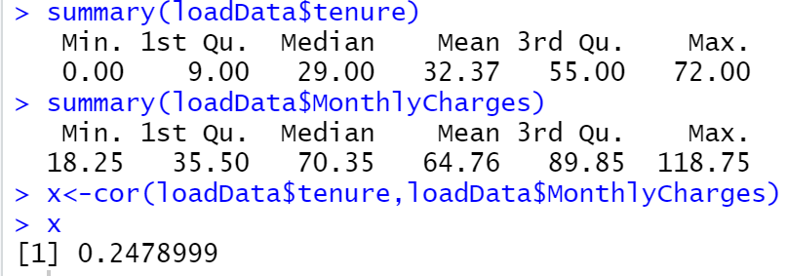
Descriptive Analytics

Slide 6
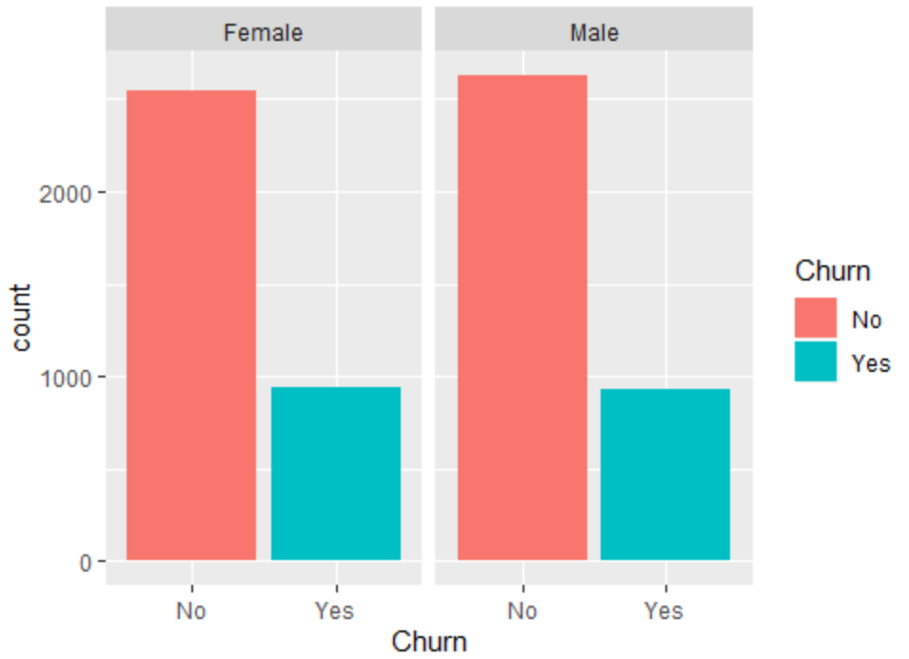
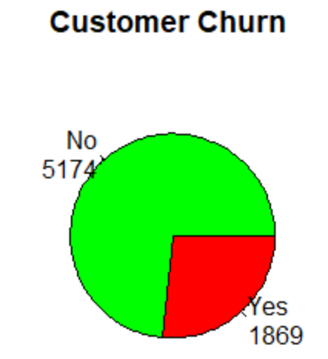
Data Visualization

Slide 7
Predictive Analysis
Classifiers
Decision Tree
Naïve Bayes
Logistic Regression

Slide 8
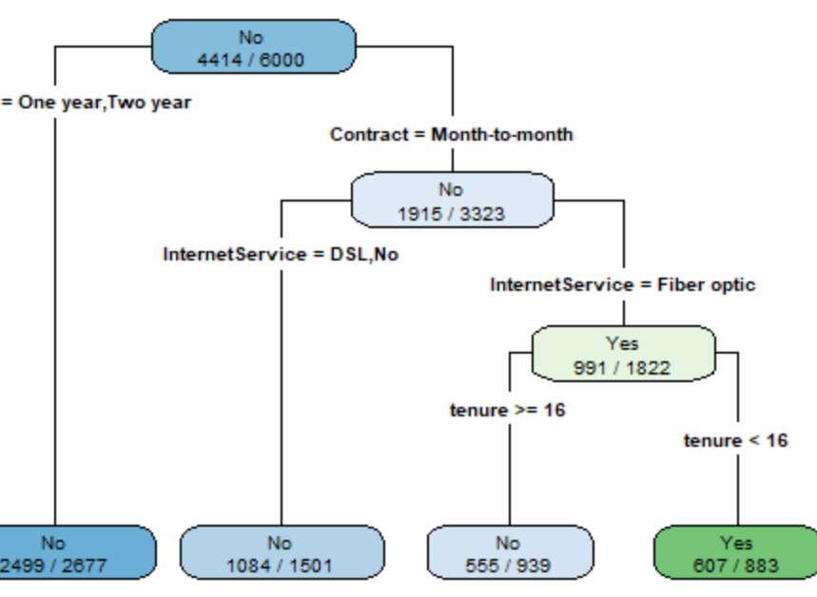
Decision Tree
Decision Rules:
If Contract=Month-to Month, InternetService = FiberOptic, AND tenure<16 then Churn is Yes
If Contract=Month-to Month, InternetService = FiberOptic, AND tenure >=16 then Churn is No
If Contract=Month-to Month AND InternetService = DSL,No, then Churn is No
If Contract= One year, Two year then Churn is No

Slide 9

Naïve Bayesian
Naive Bayes model is a generative model
It handles missing values and high dimensional data well when compared to other classifiers.
Input: Inserting all the variables into the model
Output: Calculating the posterior probability and providing the churn prediction model, accuracy and its overall performance

Slide 10
Implementation & Validation
Naïve Bayesian is a 3 – Step Process:
1- Prior probability for class
2-Likelihood of X given class C1:
3.Posterior probability of X1 being C1

Slide 11
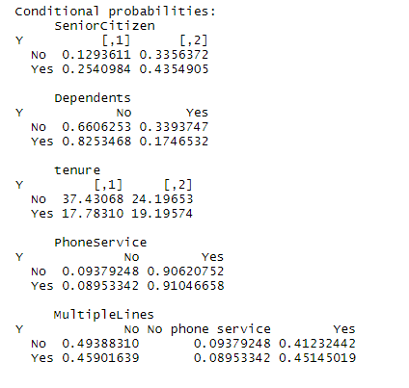

1- Prior probability for Churn
2-Likelihood of X given class Churn

Slide 12
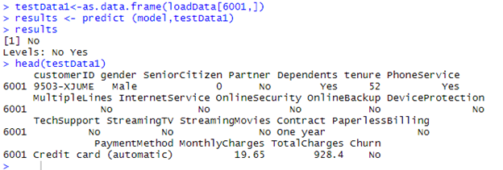
3.Posterior probability of X being Churn

Slide 13


Performance
Confusion Matrix
Accuracy

Slide 14
Interpretations
632 correctly predicted as Non-churner customer from 727 which is (86.9%)
188 correctly predicted as Churner customer from 317 which is (59.3%).
Accuracy-78.4%

Slide 15
Limitations
Naïve Bayes assumes all the features to be conditionally independent
Here there exists some correlation between the variables {Internet services} and {OnlineSecurity, OnlineBackup, DeviceProtection, TechSupport, StreamingTV, StreamingMovies}.
Naïve Bayes cannot handle numerical data well when compared to Decision Tree classifier.

Slide 16
Logistic Regression
Data Preparation
Selection of Variables
Final Model
Interpretations
Testing
Performance as Classifier

Slide 17
Logistic Regression
Data Preparation
Remove the colinearity.
Selection of Variables
Log Likelihood Test
Backward Step wise method
Pchisq()

Slide 18
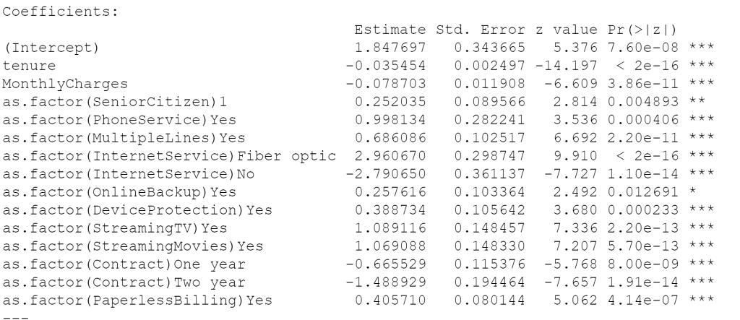
Logistic Regression- Final Model

Slide 19
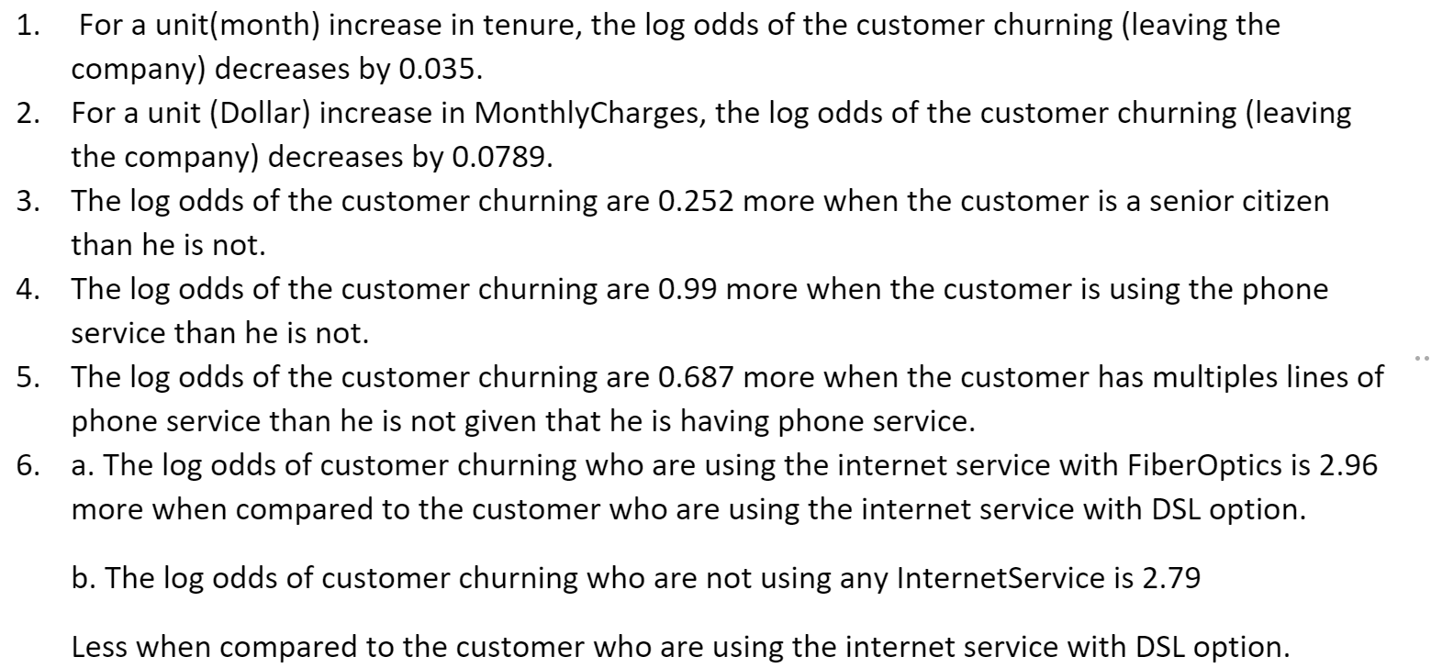
Logistic Regression -Interpretations
The log odds of customers churning impacted by the variables

Slide 20
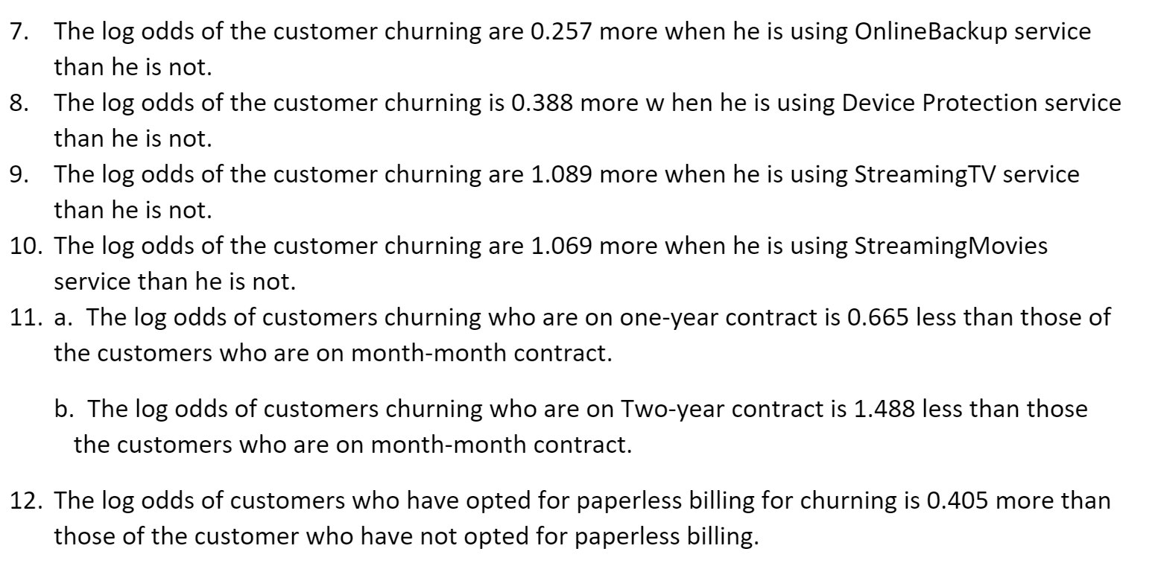
Logistic Regression -Interpretations
The log odds of customers churning impacted by the variables.

Slide 21
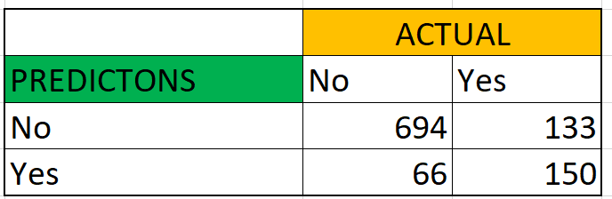
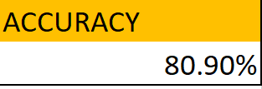
Logistic Regression -Testing
Confusion Matrix
Accuracy Rate

Slide 22
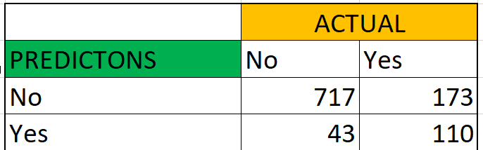
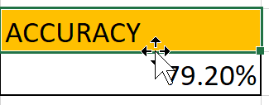
Decision Tree-Testing
Confusion Matrix
Accuracy Rate

Slide 23
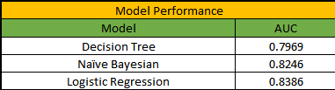
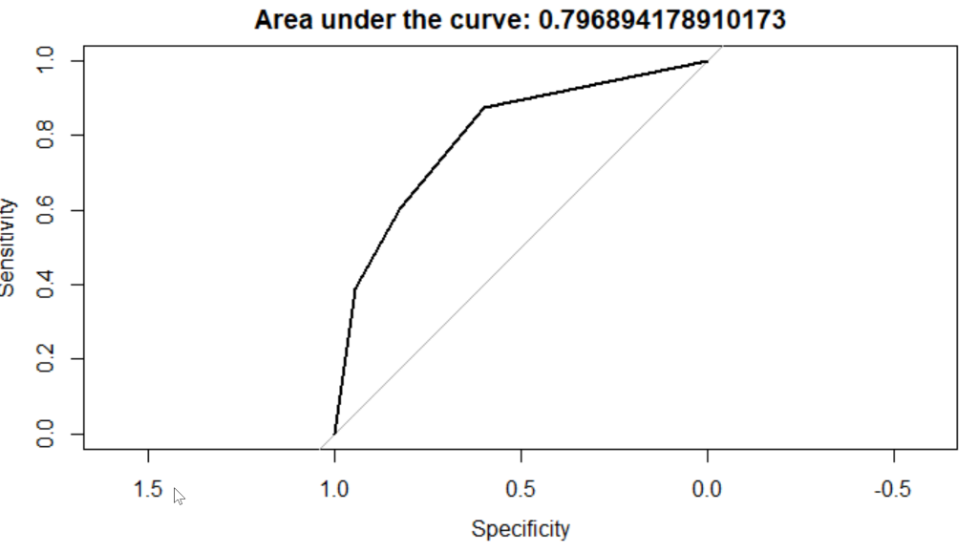
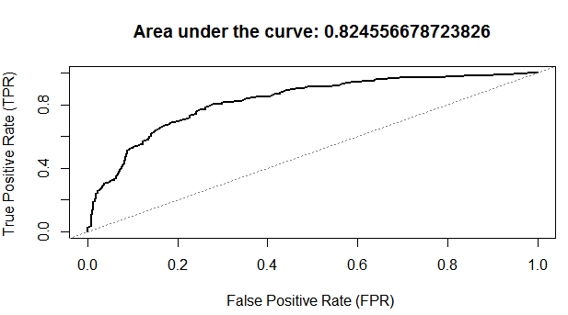
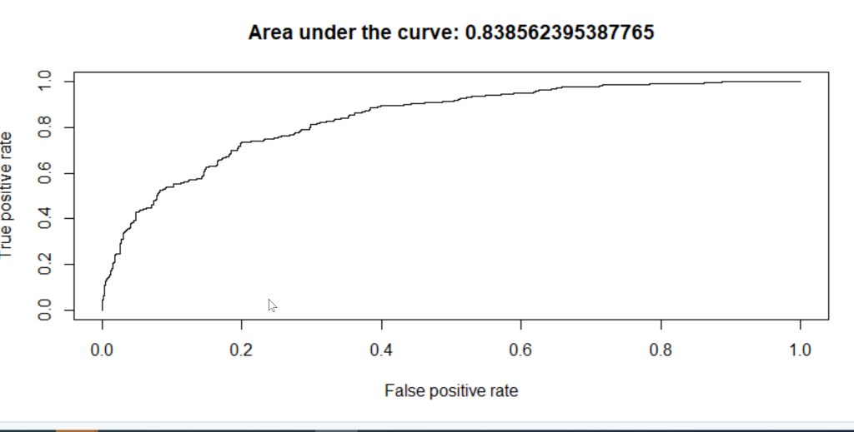

Slide 24
Conclusion
Based on the AUC values, Logistic Regression is giving the best prediction model with 83.86%
Which Customers are likely to Churn
Which features have the most impact on customer leaving
From the models, we found

Slide 25


Conclusion
Feature | Impact
Tenure | Positive
Monthly Charges | Positive
Senior Citizen | Negative
Phone Service | Negative
Multiple Lines | Negative
Internet service- Fiber Optics | Negative
Based on the prediction model, the features influencing the customers churn

Slide 26
Recommendations
Approach the customers likely to churn with these features, and making appropriate changes will bind them to the company
Building exclusive offers and promotions targeted towards seniors
Adjust the relevant criteria
On Boarding program
Customer Feedback Loop
Targeting Business users for Fiber Optics Internet Service
Referral programs

Slide 27



Thank You

